Slide 1

APACHE SQOOP
Bigdata Eco system

Slide 2
Agenda
What – Why – When & History about Sqoop
Where Sqoop Fits in Bigdata Ecosystem
Sqoop Architecture
Components in Sqoop
Sqoop Operations
Sqoop2
Sqoop Vs Sqoop2
Configurations Files / Settings
Demo
Best Practices
FAQ
Test Yourself
References
Assignment

Slide 3
What – Why – When & History about the Framework
Sqoop is a command-line interface (CLI) tool for transferring data between relational databases/data warehouses and Hadoop
It extracts data from Hadoop and exports it into external structured datastores and extracts data from RDBMS and imports into Hadoop File System/Hbase/Hive
It helps offload certain tasks such as ETL processing from the Enterprise Data Warehouse to Hadoop for efficient execution at a much lower cost
Written in java language and its stable release was ‎1.4.6 as on May 11, 2015
Integrates with Apache Oozie (Workflow Scheduler) as an action (Sqoop jobs)
Sqoop invokes drivers and connectors through JDBC & SQL

Slide 4
What – Why – When & History about the Framework
Sqoop Evolution
Sqoop initially started as a contribution module for Apache Hadoop in May of 2009, first submitted as a patch to HADOOP-5815 by Aaron Kimball
In April of 2010, Sqoop was taken out from Hadoop via MAPREDUCE-1644 due to its inertia of large projects, patches submitted and hosted it on GitHub by Cloudera as an Apache Licensed project
Sqoop successfully graduated from the Incubator in March of 2012 and had been released to the public with a variety of updates since then
Sqoop Versions
Sqoop 1.4.6 (Stable release as of now)
Sqoop 1.4.7 (Current Version of Sqoop)
Sqoop 1.99.7 (Latest cut version of Sqoop2)

Slide 5
















Where Sqoop Fits in Bigdata Ecosystem
HDFS
HBASE
MongDB
Cassandra
Sqoop
Flume
Kafka
Data Store
Streaming
Engines
MR
Storm
Spark
Data Processing
Hive
Phoenix
Drill
Zeppelin
Data Services
Falcon
Oozie
Zookeper
Ranger
Atlas
Peripherals

Slide 6
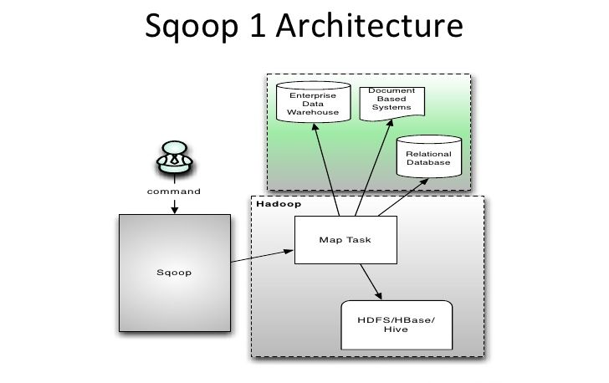
Sqoop Architecture
High level components
Sqoop CLI
RDBMS/Data Warehouses
RDBMS – MySQL, Oracle, PostgreSQL
Data Warehouses – Teradata, AWS, Oracle
Hadoop
Map Task
HDFS/HBase/Hive

Slide 7
Components in Sqoop
Sqoop CLI – This is the primary utility of Sqoop that acts as an interface between RDBMS and Hadoop framework through which user can perform the Sqoop operations such as export & import
RDBMS/Data Warehouse – System that holds the data in structured format (tables) and can be a source/target for data to be imported or exported to Hadoop
MySQL, Oracle & PostgreSQL are few examples of RDBMS
Teradata, AWS & Oracle are few examples of Data Warehouses
Hadoop – System that holds large sets of data as files or records and can be used for faster processing of data rather than the traditional RDBMS or Datawarehouses
Map Task – Executes a copy of the query (during import) with results partitioned by bounding conditions inferred by Sqoop. User can define the number of mappers (default being 4) during import or export in the Sqoop CLI
HDFS/HBase/Hive – Data from RDBMS is stored in Hadoop in any of the three systems based on the user’s requirement and specifications

Slide 8
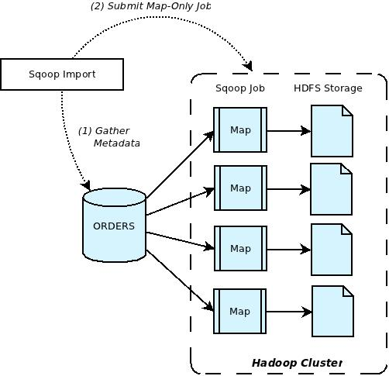
Sqoop Operations
Sqoop Import
Imports a table from RDBMS to HDFS as a file
Each row from a table is represented as a separate record in HDFS and the records can be stored as text files (one record per line), or in binary representation as Avro or SequenceFiles
Sqoop Import can be performed by the use of ‘Sqoop import’ command with some parameters based on user preference as follows,
sqoop import -connect jdbc:RDBMS_NAME://hostname:port/service_name
-username <user_name> -password <password>
-table_name -m <mapper_count>
--split-by <columns_name> --fields-terminated-by <,>
--columns <column_name>
--target-dir <location>
--incremental <append>
--check-column <column name>
--last value <last check col value>
--hive-import

Slide 9
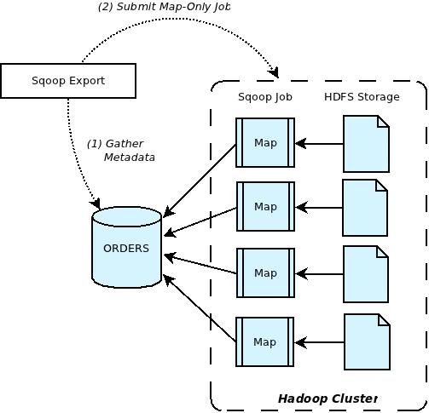
Sqoop Operations
Sqoop Export
Exports a file from HDFS to RDBMS as a table
Files given as input to Sqoop contain records, which are called as rows in a table
Files are read and parsed into a set of records and delimited with delimiters and then load into RDBMS
Sqoop Export can be performed by the use of ‘Sqoop export’ command with some parameters based
on user preference as follows,
sqoop export -connect jdbc:RDBMS_NAME://hostname:port/service_name
-username <user> -password <password>
-table_name -m <mapper_count>
--export-dir <dir>
--call <stored-proc-name>
--columns <column_name>
--staging-table <table-name>
--update-mode <mode>

Slide 10
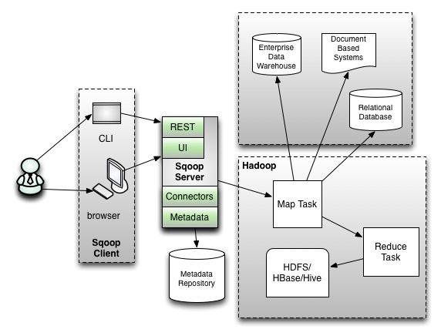
Sqoop2
Sqoop 2 is the next version of Sqoop that overcomes the limitations of Sqoop
It uses a service based model where the connectors/drivers are installed on the Sqoop 2 server
A server-based tool designed to transfer data between Hadoop and relational databases
Import data from a RDBMS such as Oracle/MySQL into HDFS, transform the data with Hadoop MapReduce, and then export it back into RDBMS system
Provides strong support for command line interaction, while adding a web-based GUI that exposes a simple UI
A user can walk through an import/export setup via UI cues which can eliminate redundant options

Slide 11
Sqoop Vs Sqoop2
Sqoop uses a client model where the user needs to the install Sqoop along with connectors/drivers on the client
Sqoop2 uses a service based model, where the connectors/drivers are installed on the Sqoop2 server
Sqoop submits a Map only job, while Sqoop2 submits a MapReduce job where the Mappers would be transporting the data from the source, while the Reducers would be transforming the data according to the source specified
In Sqoop, the administrator would be setting up the connections to the source and the targets, while the operator user uses the already established connections
In Sqoop 2, the CLI and the Web UI consume the REST services provided by the Sqoop Server and the Sqoop2 REST interface also makes it easy to integrate with other frameworks like Oozie to define a work flow

Slide 12
Configurations Files / Settings

Slide 13
Configurations Files / Settings
Locate the following files and modify the properties based on your environment.
In sqoop-env.sh, make the following changes:
export HADOOP_HOME=${HADOOP_HOME:-/usr/hdp/current/hadoop-client}
export HBASE_HOME=${HBASE_HOME:-/usr/hdp/current/hbase-client}
export HIVE_HOME=${{HIVE_HOME:-/usr/hdp/current/hive-server2}
export ZOOCFGDIR=${ZOOCFGDIR:-/etc/zookeeper/conf}
Add the following export statements to .bashrc file
export SQOOP_HOME=/usr/lib/sqoop
export PATH=$PATH:$SQOOP_HOME/bin
Add JDBC jar file provided by the Database / DW vendor to $SQOOP_HOME/lib directory for DB / DW connectivity (if the JDBC jar doesn’t exits in $SQOOP_HOME/lib )

Slide 14
Demo

Slide 15
Demo
Sqoop Import (RDBMS --> HDFS)
Imports data from MySQL to HDFS
sqoop import -connect jdbc:mysql://192.168.55.242:3306/cwcsprint –username root -password root -table alametrics -m 1
Imports data from Oracle to HDFS
sqoop import -connect jdbc:oracle://lx01s172.corp.paetec.com:1521/MTSVALP -username asapit - password asap -table defaults -m 3
Sqoop Import (RDBMS --> Hive)
Imports data from MySQL to Hive
sqoop import -connect jdbc:mysql://192.168.55.242:3306/cwcsprint –username root -password root -table alanmetrics -m 1 --hive-import --hive-table test_MySQL
Imports data from Oracle to Hive
sqoop import -connect jdbc:oracle://lx01s172.corp.paetec.com:1521/MTSVALP -username root -password root -table circuit -m 3 --hive-import –-hive-table test_Oracle

Slide 16
Demo
Sqoop Import (RDBMS --> HBase)
Imports data from MySQL to HBase
sqoop import -connect jdbc:mysql://192.168.55.242:3306/cwcsprint -username root -password root -table -m 1--hbase-table test_MySQL
Imports data from Oracle to HBase
sqoop import -connect jdbc:oracle://lx01s172.corp.paetec.com:1521/MTSVALP -username root -password root -table -m 3 –hbase-table test_Oracle
Sqoop Export (Hive --> RDBMS)
Exports data to MySQL from Hive
sqoop export --connect jdbc:mysql://192.168.55.242:3306/cwcsprint -username hive -password hive -table testdata --direct --export-dir /apps/hive/export_data --driver com.mysql.jdbc.Driver
Exports data to Oracle from Hive
sqoop export --connect jdbc:oracle://192.168.55.242:3306/cwcsprint -username hive -password hive -table testdata --direct --export-dir /apps/hive/export_data --driver com.mysql.jdbc.Driver

Slide 17
Demo
Sqoop Export (HBase --> RDBMS)
Sqoop Export for Hbase is not possible directly but possible via Hive
As of Sqoop 1.4.6, Sqoop does not support Hbase export to any database.
However, we can have a workaround in place for this issue.
Create a hive table on top of Hbase table and make use of Hive table to perform the export via Sqoop

Slide 18
Best Practices

Slide 19
Best Practices
Never use the password credentials directly in a Sqoop command using -password parameter but rather use -p parameter to prompt for the same when executed to make it secure
It is always preferred to have the mappers set to its default 4 rather than increasing them using –m parameter
Scheduling an Oozie job at scheduled timeframe is more efficient rather than adding an incremental import to Sqoop command as it could hinder performance during large data transfer

Slide 20
FAQ

Slide 21
FAQ
What are the pre-requisites for installing Sqoop?
Java v1.7 or greater
Hadoop v2 or greater (If it is not configured properly, then Sqoop won’t work properly)
Does Sqoop has any security concerns?
Openly shared credentials in import/export commands could be a problem when multiple users are associated with Sqoop. Users need to use the -p parameter to prompt password from console rather than printing it with import command to make it secure
What are the connectors that Sqoop uses?
Sqoop connectors are forced to follow the JDBC model and are required to use common JDBC vocabulary (URL, database, table, etc) only. No ODBC or any other connectors are available
Mention any difficulties that users might face in Sqoop?
It is difficult to manage installation or configuration due to the unavailability of root privileges
Users cannot work on any configuration activates unless root access is given
Can we transfer the data between NoSQL systems and Hadoop using Sqoop?
Sqoop can only transfer data between RDBMS systems and Hadoop but not with any NoSQL systems. However, it is possible to transfer the data between NoSQL systems and Hadoop using separate connectors

Slide 22
Test Yourself

Slide 23

Test Yourself
Answer the below Questions
What is the command to import data to Hive?
What is Apache Sqoop?
sqoop import -connect jdbc:rdbms_connection://hostname:port/serv_name -username <user> -password <pwd> -table <tab_name> -m <num_of_mappers>
Sqoop is a CLI tool that can transfer data between RDBMS and Hadoop systems
What is the command to perform incremental operations in Sqoop?
Provide the key components of Sqoop
Sqoop CLI, RDBMS, Hadoop(HDFS/Hive/Hbase)
sqoop import -connect jdbc:rdbms_conn://hostname:port/serv_name -username <user> -password <pwd> -table <tab_name> -m <num_of_mappers> --query <sql_query_with_condition> --incremental <lastmodified> or <append> --check-column <col_name> --last-value <max_value_of_previous_import>
Define Sqoop Import & Export.
Where can we find the records failure information during Import in Sqoop?
Import – Sqoop imports data from RDBMS (MySQL, Oracle) to HDFS/Hive/Hbase
Export – Sqoop exports data from HDFS/Hive/Hbase to RDBMS (MySQL, Oracle)
Find Map task logs under 'Resource Manager web UI' in Ambari monitoring tool, then navigate to map reduce job, click on failed map task to find out the failed records

Slide 24
References

Slide 25
Reference Links
Sqoop site: https://sqoop.apache.org/
Download: http://redrockdigimark.com/apachemirror/sqoop/
Sqoop Forums: https://hortonworks.com/apache/sqoop/#forums
https://blogs.apache.org/sqoop/
Sqoop Repository: https://git-wip-us.apache.org/repos/asf?p=sqoop.git;a=summary
Documentation:
Sqoop Guide: https://sqoop.apache.org/docs/1.4.6/index.html
API Guide: https://sqoop.apache.org/docs/1.4.6/api/index.html
User Guide: https://sqoop.apache.org/docs/1.4.6/SqoopUserGuide.html
Dev Guide: https://sqoop.apache.org/docs/1.4.6/SqoopDevGuide.html
Admin Guide: https://sqoop.apache.org/docs/1.99.7/admin.html
Admin Tools: https://sqoop.apache.org/docs/1.99.7/admin/Tools.html

Slide 26
Assignment

Slide 27
Assignment
Transfer data from Oracle to HDFS using Sqoop Import and schedule data transfer periodically at a certain timeframe
Perform incremental operations in HDFS whenever data gets newly added in its associated RDBMS
Export data to MySQL from Hive
Export data from HBase to Oracle

